Slide 1
IPL Prediction
To: Mr. Najeeb Ur Rahman

Slide 2
MEET OUR TEAM
Saqlain Asif
Sadia shaheen
Abdullah ​
20021519-062
20021519-078
20021519-146

Slide 3
AGENDA
Objective
How we will predict.
Demonstration
​Reference​

Slide 4
Objective
ABDULLAH

Slide 5
objective
Predicting Match win
Predicting Best Team
Predicting Key Players of the Match
Predicting Team Total

Slide 6
Prediction
SAQLAIN ASIF

Slide 7
prediction
Ground
Opponent team
Previous record
Performance of Players

Slide 8
How we will predict.
Dataset
generation
Data
Cleaning
Attribute
Selection
Analysis of
Results
Data
Mining

Slide 9
Demonstration
SADIA SHAHEEN

Slide 10
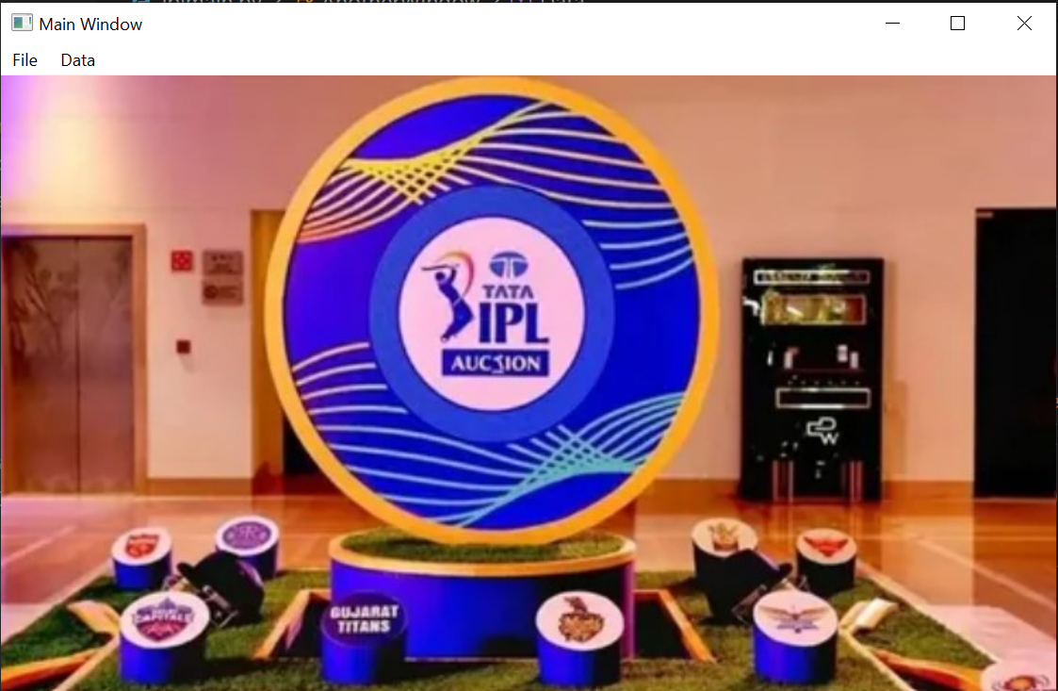

Slide 11
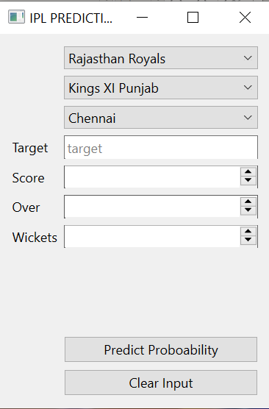

Slide 12
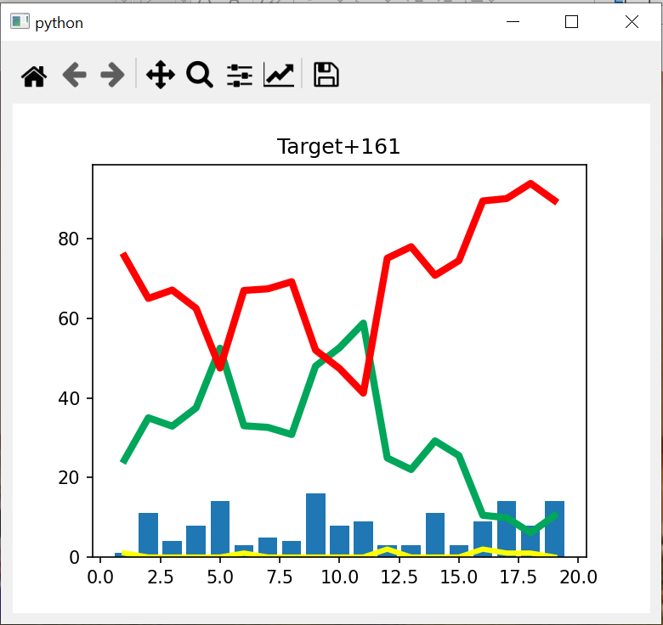

Slide 13
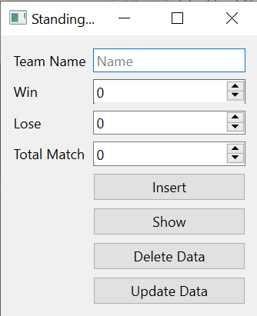

Slide 14
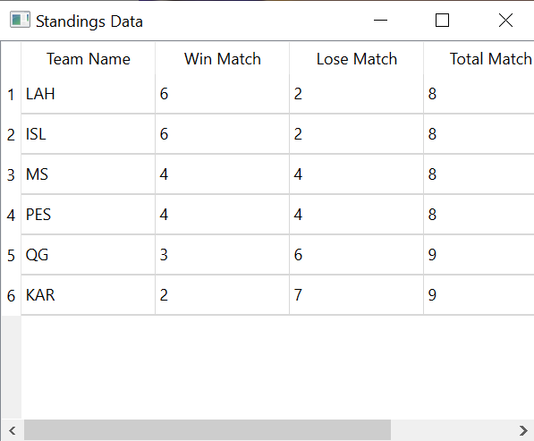

Slide 15
​Reference​
Data Set
https://www.kaggle.com/datasets/ramjidoolla/ipl-data-set

Slide 16
THANK YOU

